Slide 1



KBTG x MeowCode
Say “Hello”
Machine Learning
Jetsukda Janthornthao
AI Engineer @ Ztrus
x

Slide 2

What is Machine Learning (ML)
Main types of Machine Learning
Steps in a full ML project
Machine Learning Framework
Setup a Python Environment
for Machine Learning
Class Overview

Slide 3
What is Machine Learning (ML)

Slide 4


1. What is Machine Learning (ML)
Train
Test
Data
Machine Learning
algorithm
Patterns
Prediction
Answer
Future
Data
Model
Patterns

Slide 5

Spam Classification
Email (text) as the input
Go into classification model
Output answer whether this is spam or not.

Slide 6
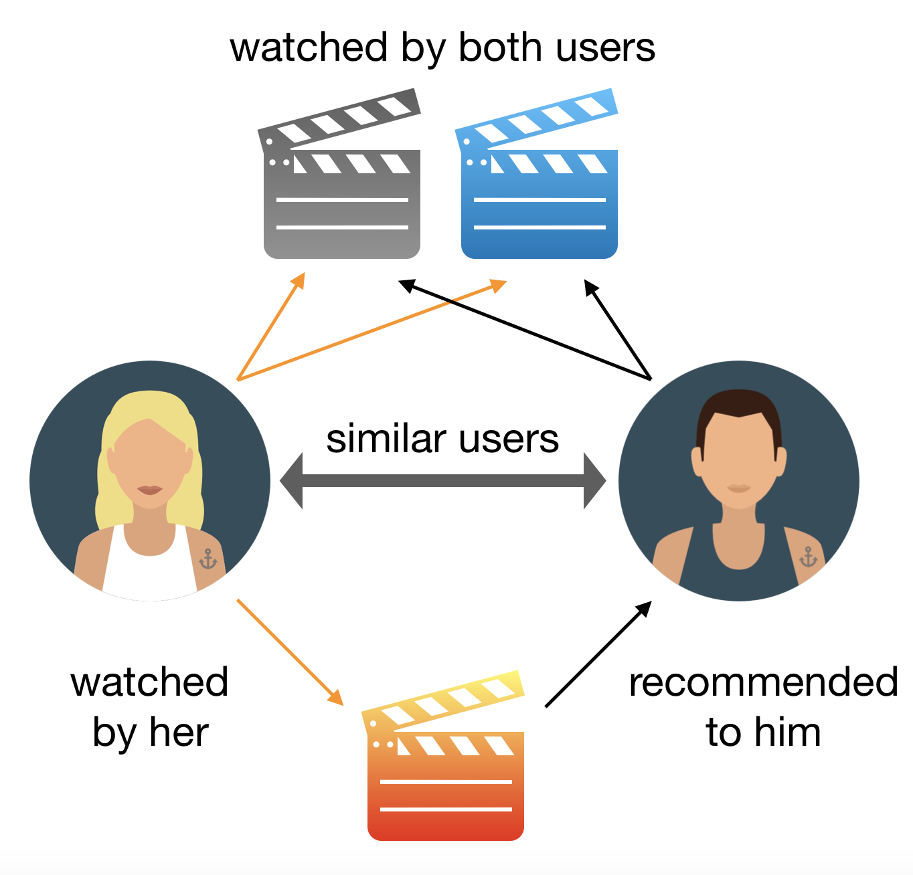
Recommended system
Recommender systems aim to predict users’ interests and recommend product items that quite likely are interesting for them.

Slide 7
Main types of Machine Learning

Slide 8
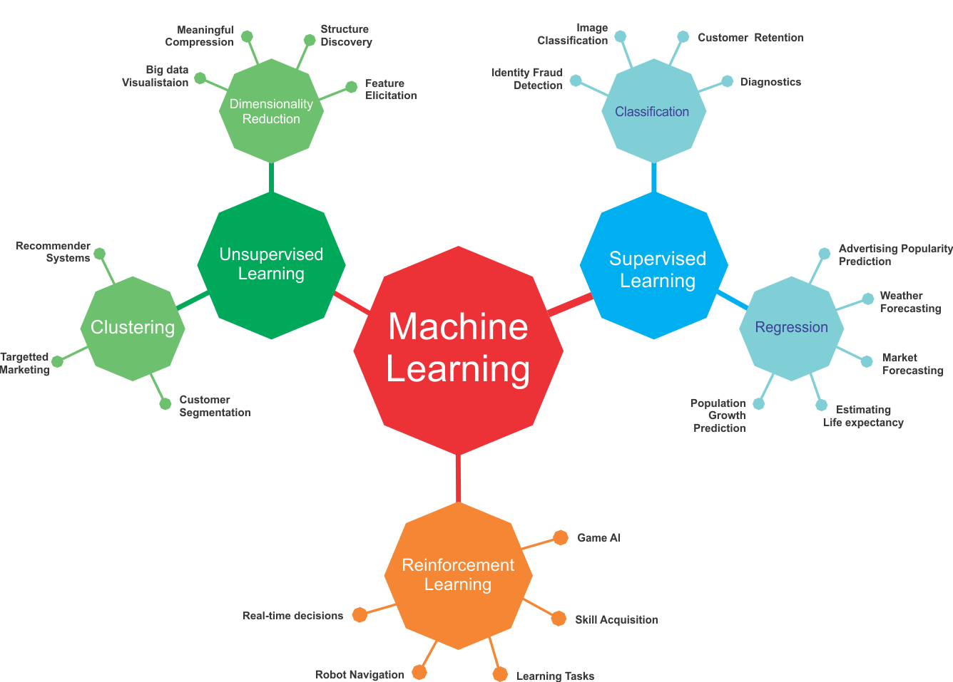
2. Main types of Machine Learning

Slide 9
Terminology about ML
Regression Problem
Predicting a continuous output (e.g. price, sales).
Classification
Predicting a categorical output.
Feature
With respect to a dataset, a feature represents an attribute and value combination.
Label
In supervised learning, the "answer" or "result" portion of an example.

Slide 10

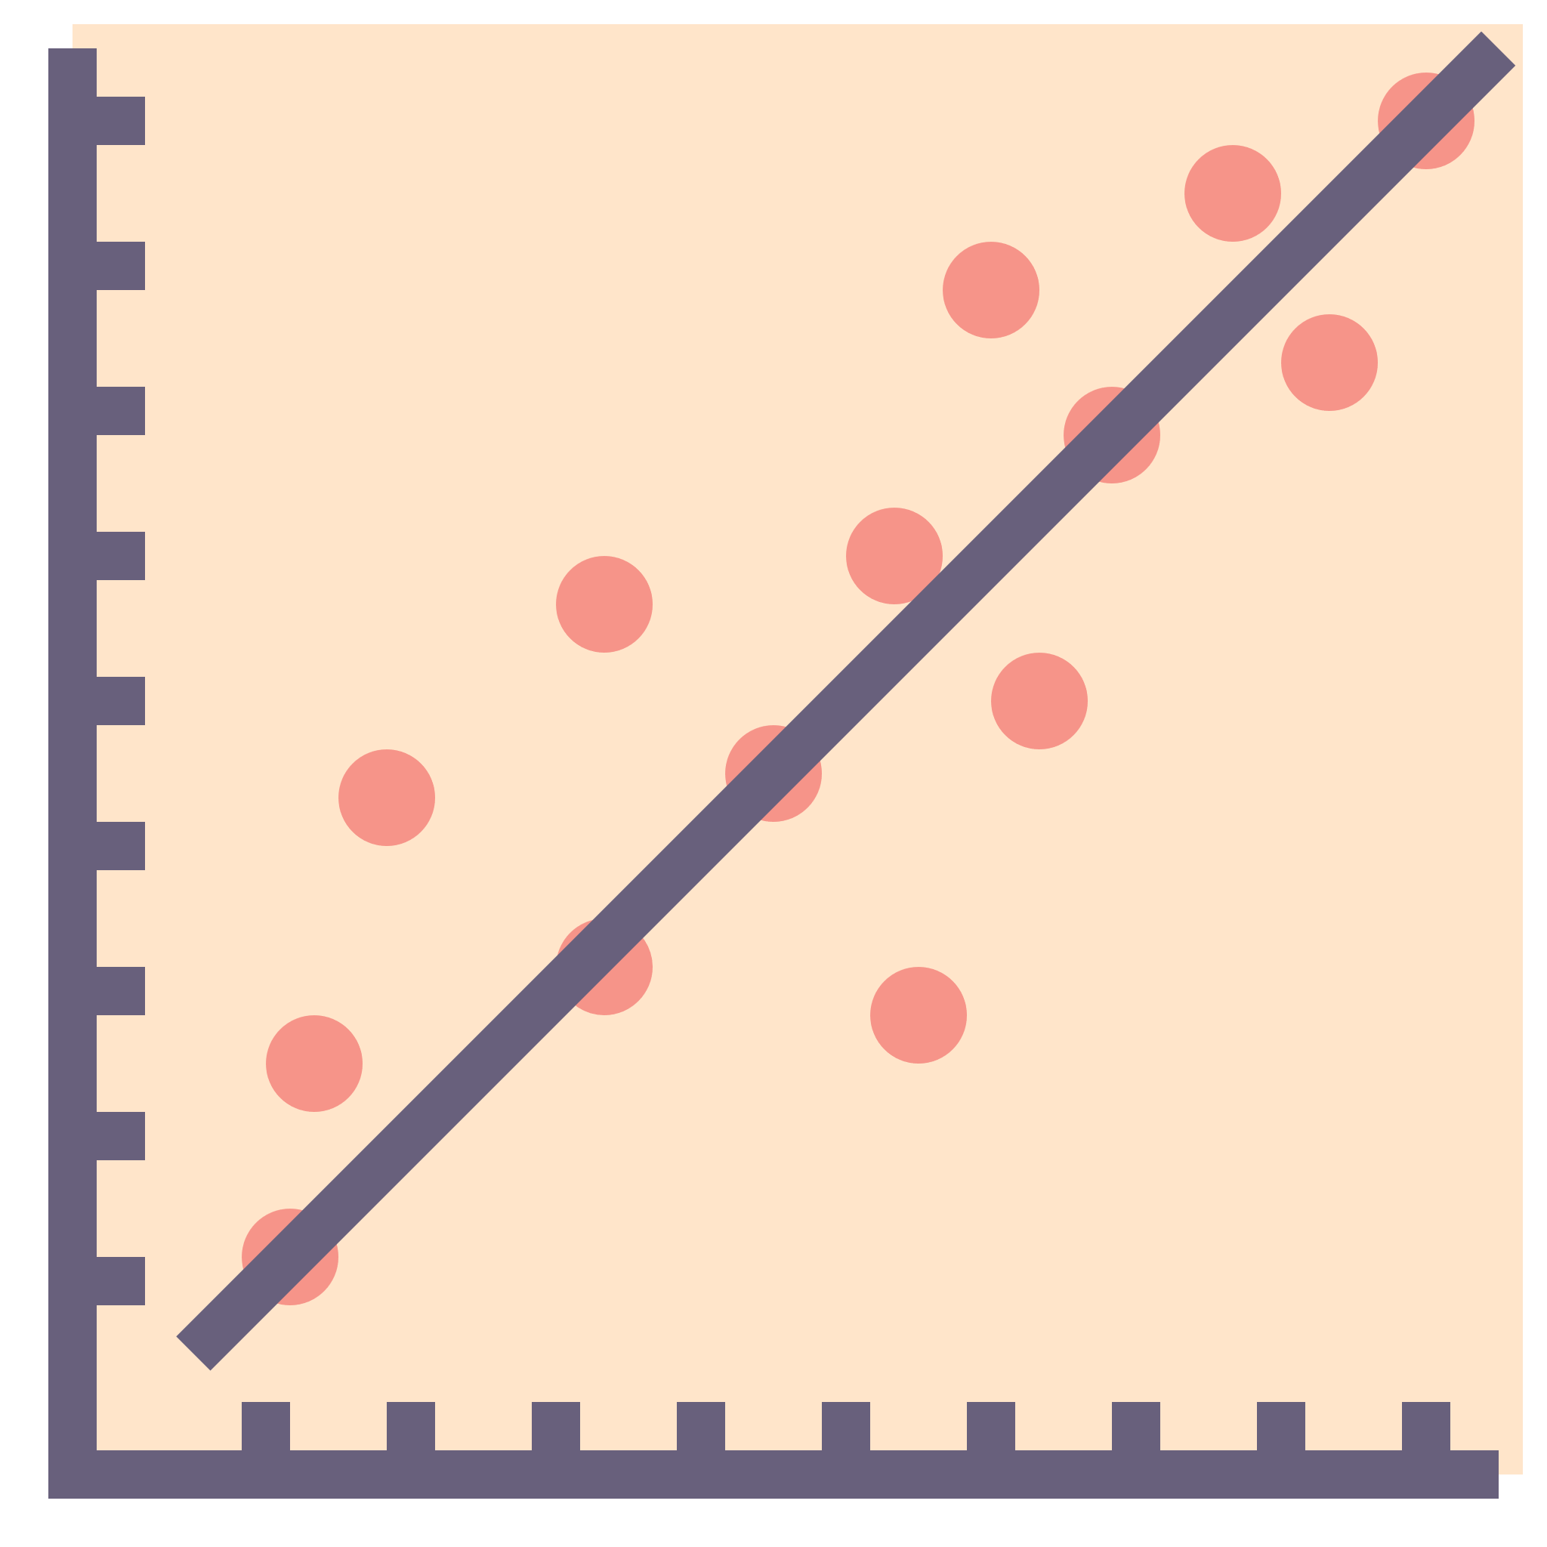
Supervised Learning
the training set you feed to the algorithm includes the desired solutions, called labels
Classification
Regression
Supervised Learning Algorithms
k-Nearest Neighbors
Linear Regression
Logistic Regression
Support Vector Machines (SVMs)
Decision Trees and Random Forests
categorical
numerical

Slide 11
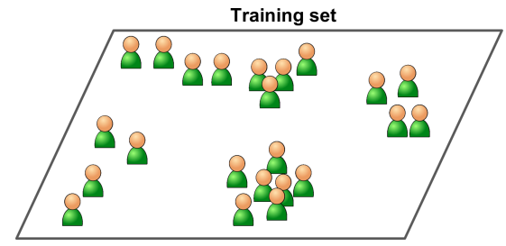
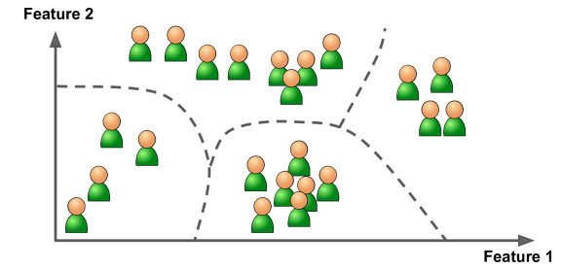
Unsupervised Learning
Training a model to find patterns in a dataset, typically an unlabeled dataset.
Unsupervised Learning Algorithms
Clustering
K-Means
Dimensionality Reduction
Principal Component Analysis (PCA)
Anomaly detection
One-class SVM

Slide 12
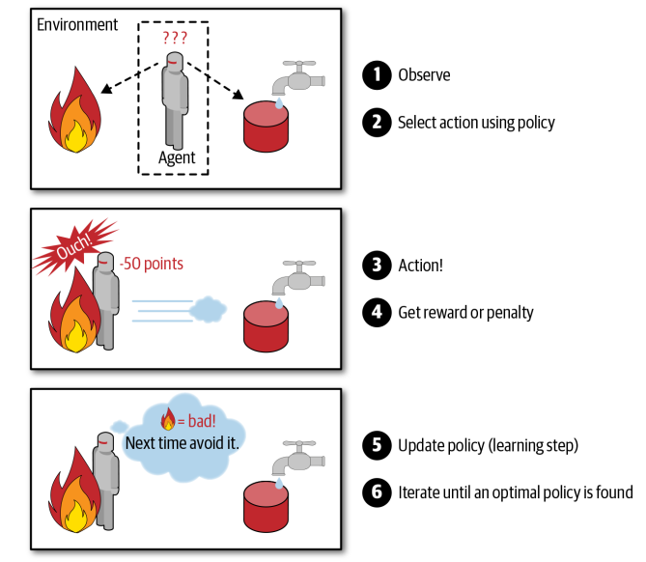
Reinforcement Learning
The learning system, called an agent in this context, can observe the environment,
select and perform actions, and get rewards in return
Reinforcement Learning Algorithms
Monte Carlo
Q-learning

Slide 13
Steps in a full ML project

Slide 14
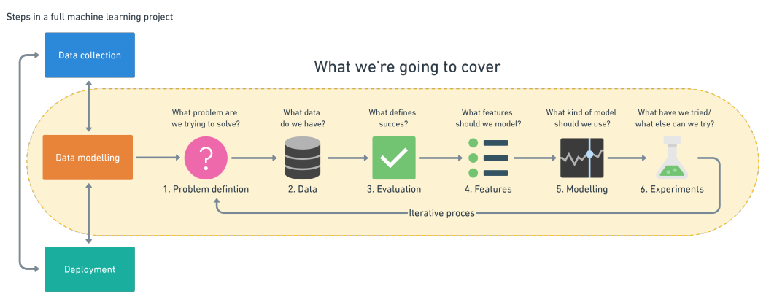
3. Steps in a full ML project

Slide 15
3.1 Problem definition

Slide 16
Supervised Learning
Classification
Binary classification
Email spam detection (spam or not).
Churn prediction (churn or not).
Multi-class classification
classify a set of images of fruits which may be oranges, apples, or pears.

Slide 17
1. Problem definition (Supervised Learning)
Supervised Learning
Regression
Predicting whether stock price of a company will increase tomorrow ?
How much will this house sell for ?
How many people will buy this app ?

Slide 18
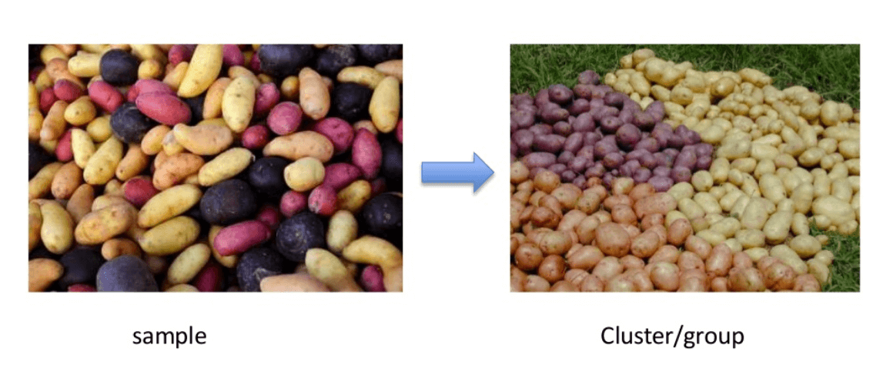
Unsupervised Learning: Clustering

Slide 19
Reinforcement Learning

Slide 20

3.2 Data
What kind of data do we have ?

Slide 21
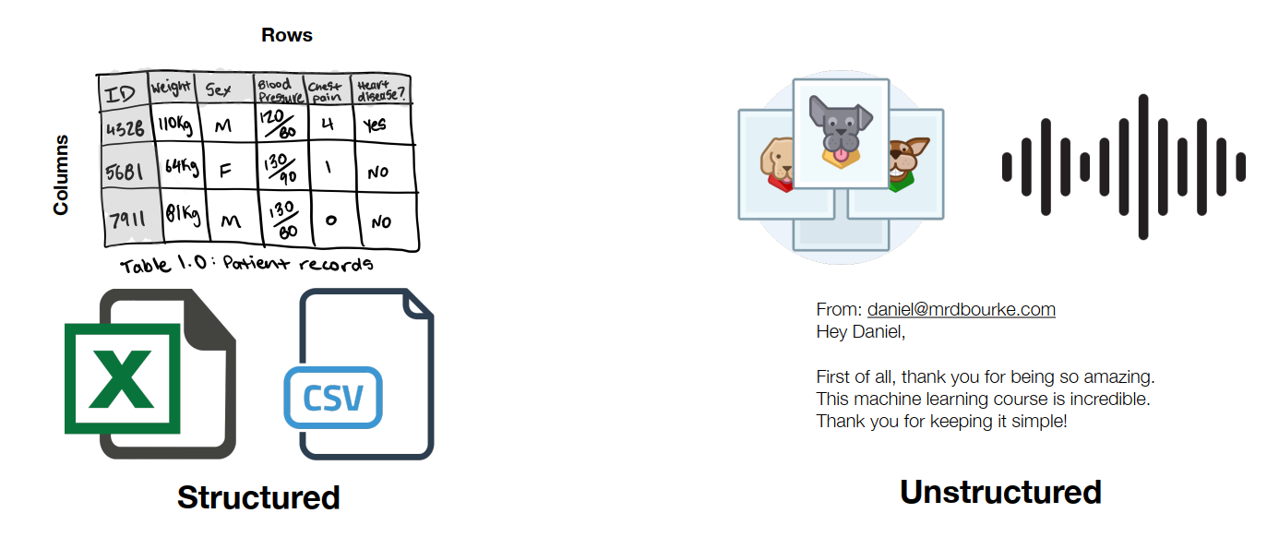
Different types of data

Slide 22

3.3 Evaluation
What defines success for us?

Slide 23
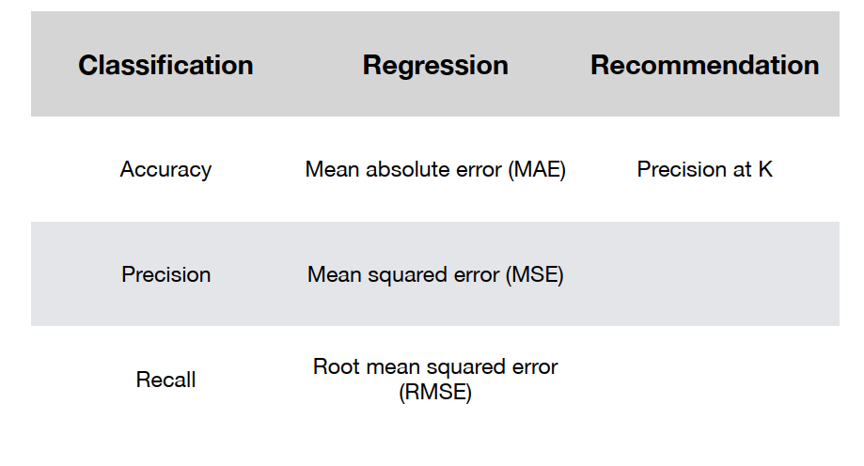
Different types of metrics

Slide 24

3.4 Features
What do we already know about the data?

Slide 25
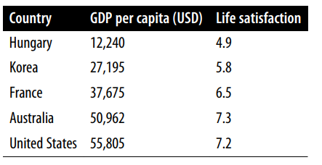
Different features of data
Categorical features
Numerical features

Slide 26
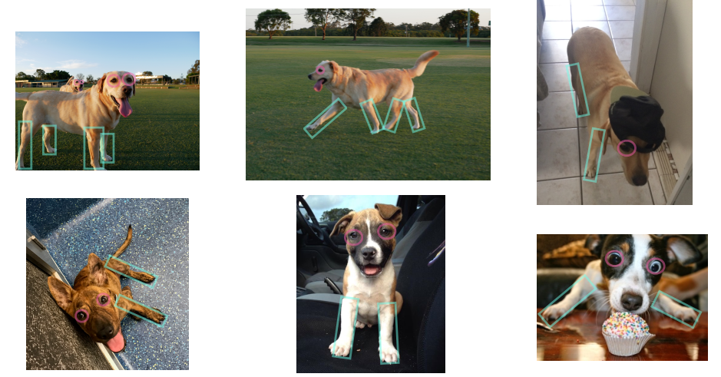
Different features of data

Slide 27

3.5 Modelling
Based on our problem and data, what model should we use?

Slide 28
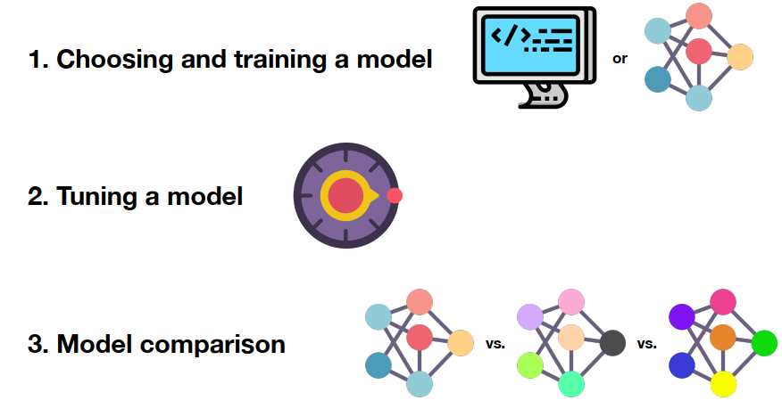
3 parts to modelling

Slide 29
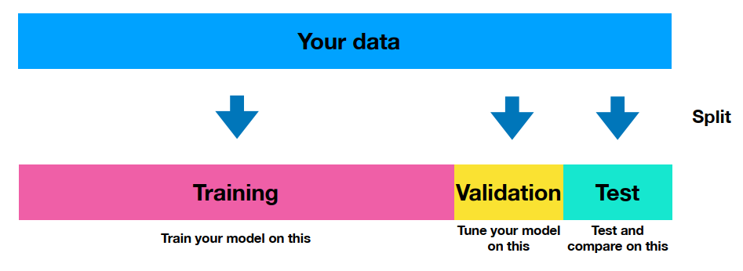
The most important concept in ML

Slide 30
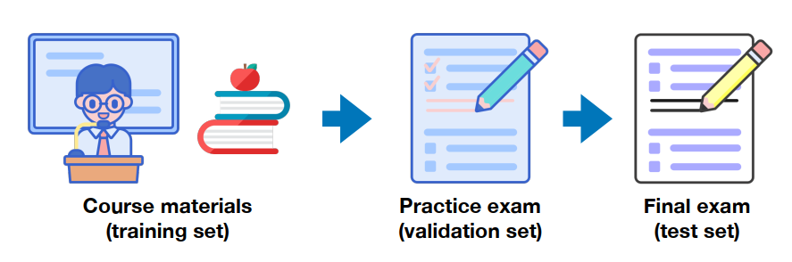
The most important concept in ML

Slide 31
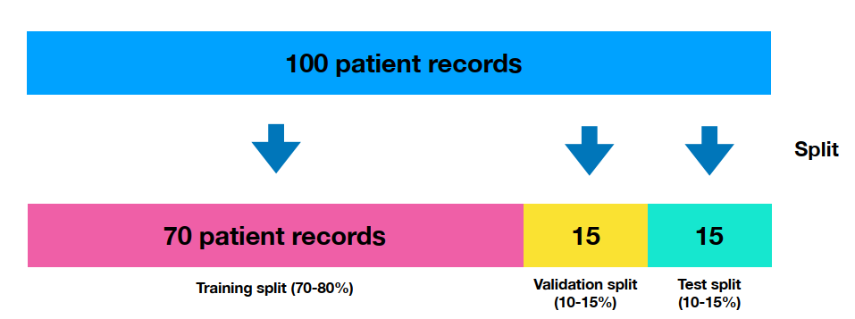
The most important concept in ML

Slide 32
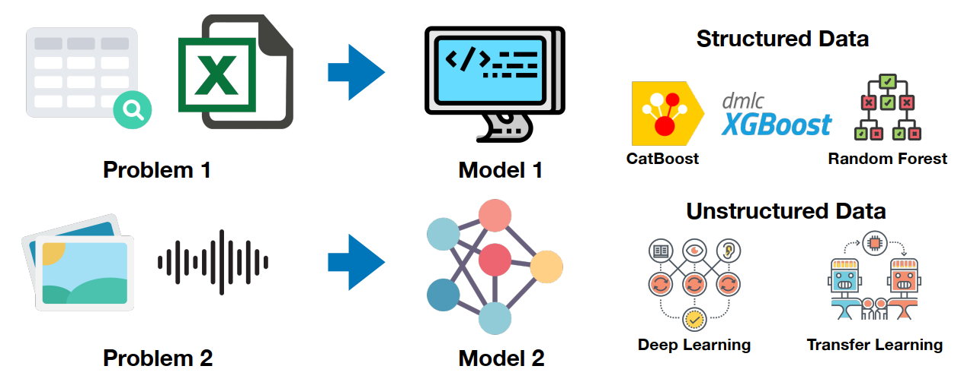
Choosing a model

Slide 33
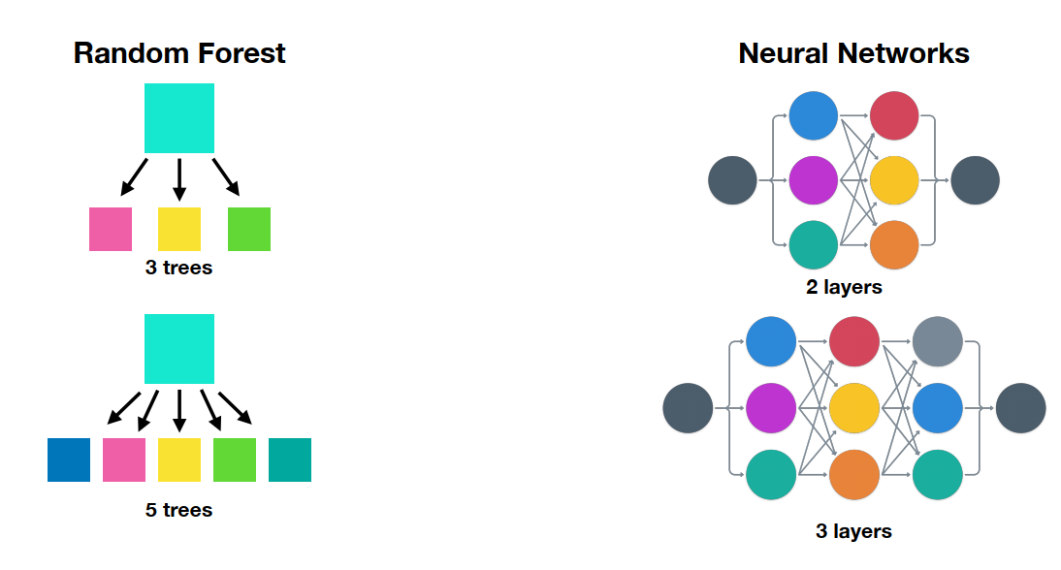
Tuning a model

Slide 34
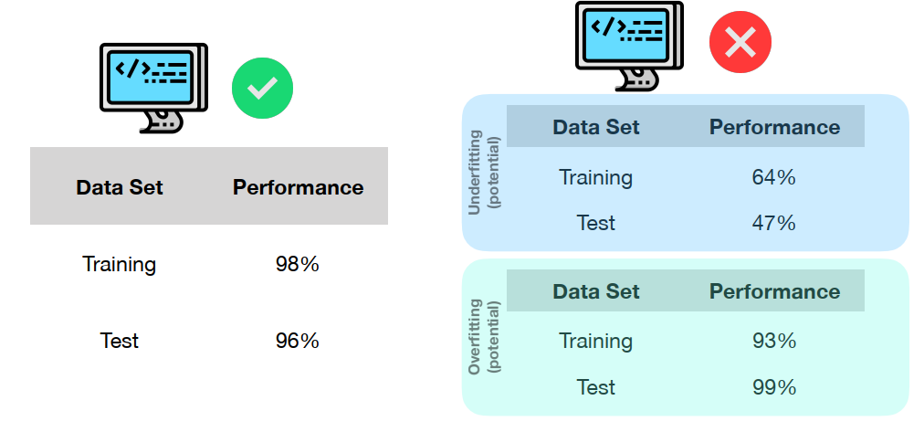
Testing a model

Slide 35
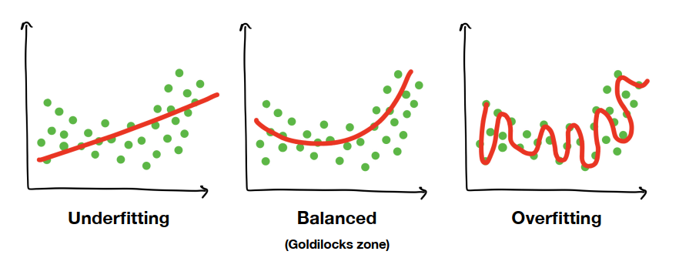
Overfitting and underfitting

Slide 36
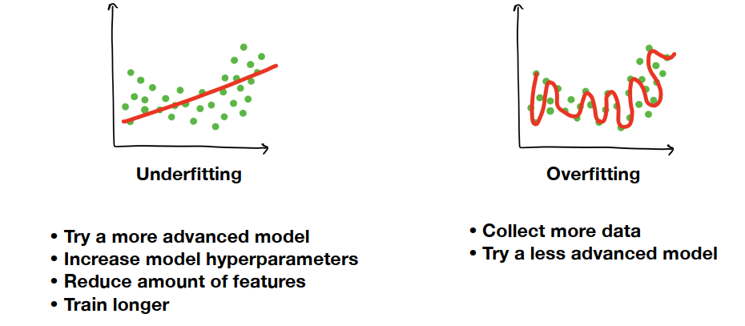
Fixes for overfitting and underfitting

Slide 37
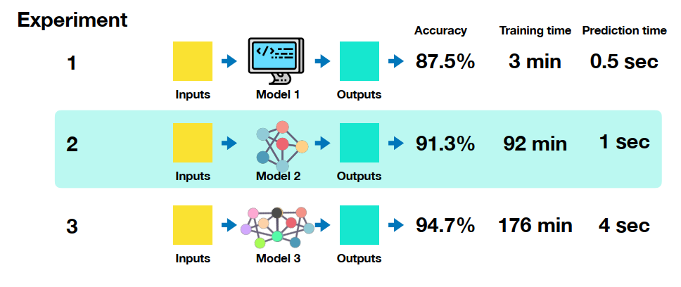
3.6 Experiments

Slide 38
Machine Learning Framework

Slide 39
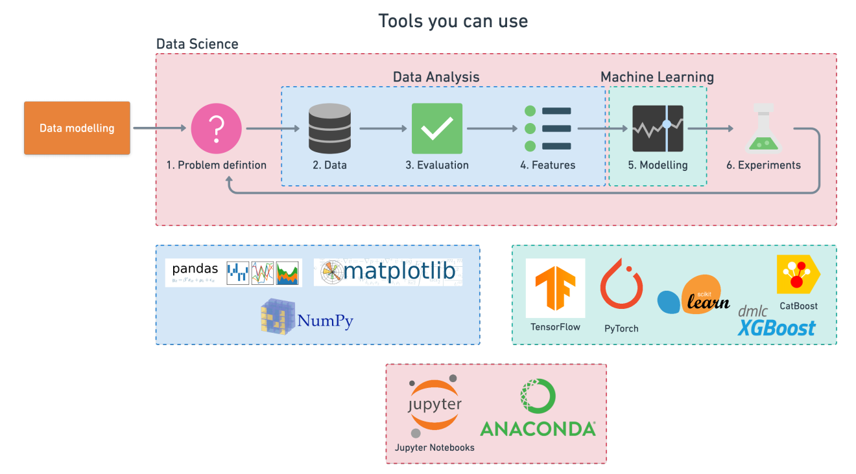
4. Machine Learning Framework

Slide 40





4. Machine Learning Framework

Slide 41
Reference
Machine Learning Glossary
zero-to-mastery-ml
machinelearning-datascience
Hands-On Machine Learning with Scikit-Learn, Keras, and TensorFlow
handson-ml2
scikit-learn: Save and Restore Models
Introduction to Machine Learning Algorithms: Linear Regression

